Slide 1
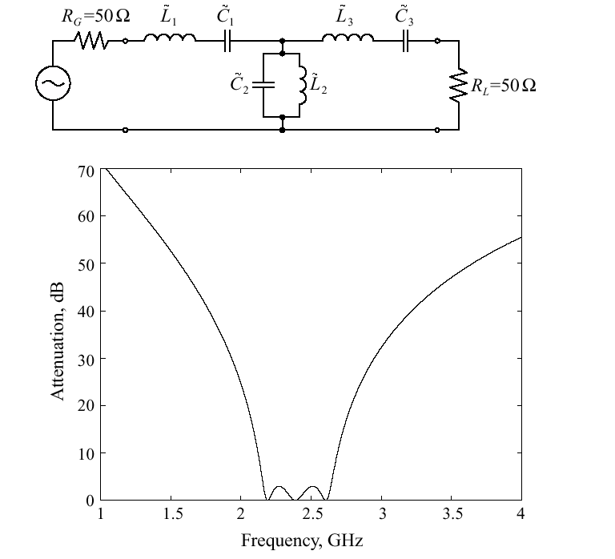
Band-Pass Filter Design Example
Attenuation response of a third-order 3-dB ripple bandpass Chebyshev filter centered at 2.4 GHz. The lower cut-off frequency is f _{L} = 2.16 GHz and the upper cut-off frequency is f _{U} = 2.64 GHz.

Slide 2
RF/μW Stripline Filters
Filter components become impractical at frequencies higher than 500 MHz
Can apply the normalized low pass filter tables for lumped parameter filters to stripline filter design
Richards Transformation and Kuroda’s Identities are used to convert lumped parameter filter designs to distributed filters

Slide 3
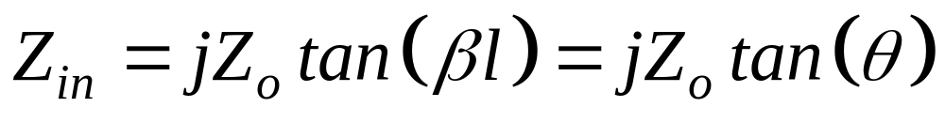
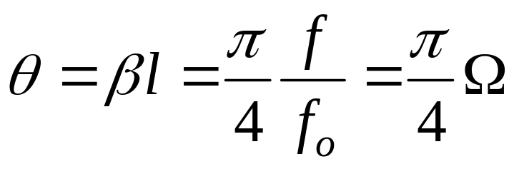
Richards Transformation:
Lumped to Distributed Circuit Design
Open- and short-circuit transmission line segments emulate inductive and capacitive behavior of discrete components
Based on:
Set Electrical Length l = λ/8 so

Slide 4
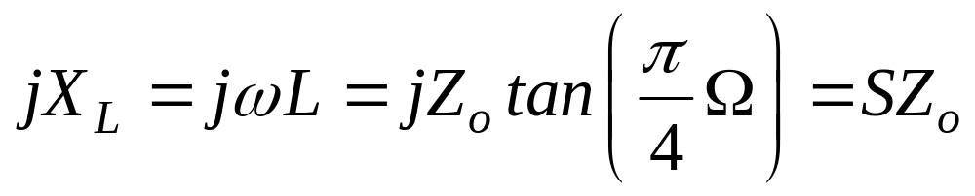
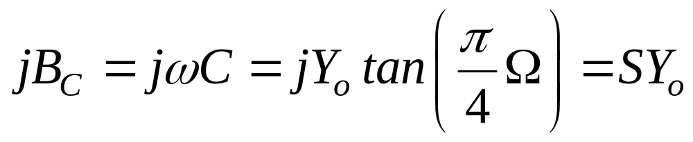
Richards Transformation:
Lumped to Distributed Circuit Design
Richards Transform is:
and
For l = λ/8, S = j1 for f = f_{o} = f_{c}

Slide 5
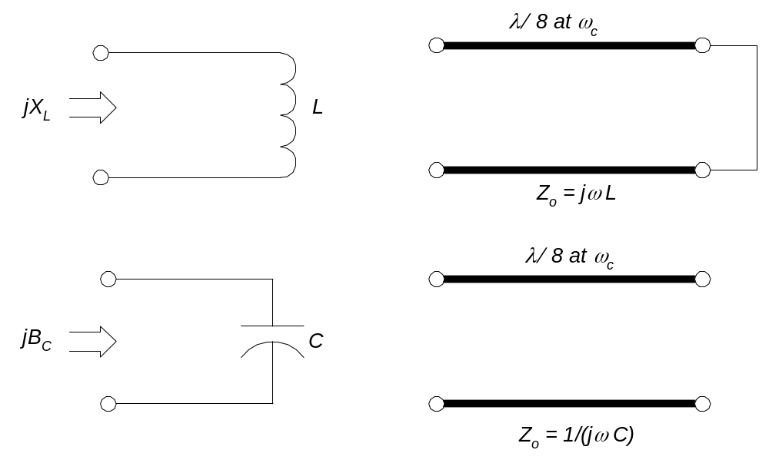
Richards Transformation:
Lumped to Distributed Circuit Design

Slide 6
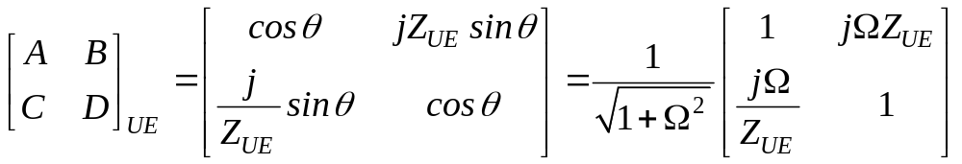
Unit Elements : UE
Separation of transmission line elements achieved by using Unit Elements (UEs)
UE electrical length: θ = πΩ /4
UE Characteristic Impedance Z_{UE}

Slide 7
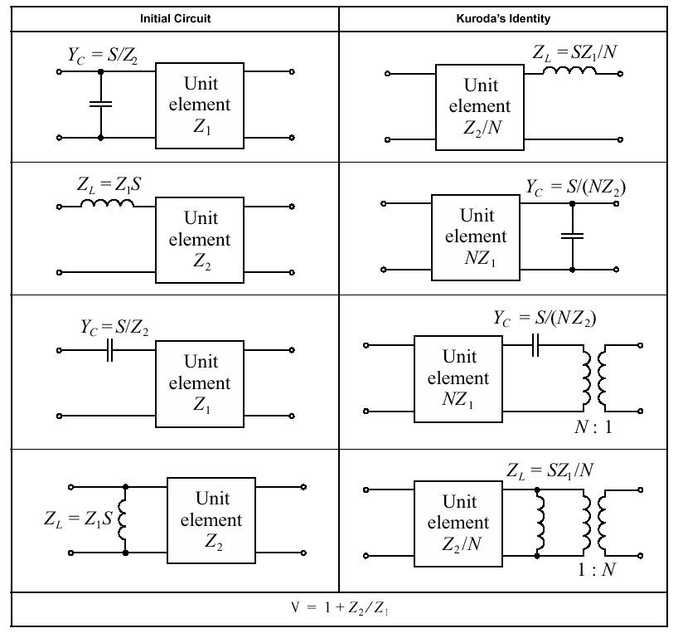
The Four Kuroda’s Identities

Slide 8
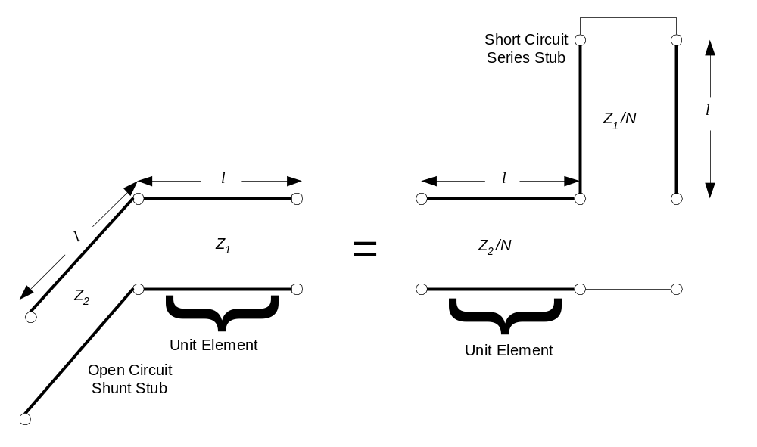
Kuroda’s Equivalent Circuit

Slide 9
Realizations of Distributed Filters
Kuroda’s Identities use redundant transmission line sections to achieve practical microwave filter implementations
Physically separates line stubs
Transforms series stubs to shunt stubs or vice versa
Change practical characteristic impedances into realizable ones

Slide 10
Filter Realization Procedure
Select normalized filter parameters to meet specifications
Replace L’s and C’s by λ_{o} /8 transmission lines
Convert series stubs to shunt stubs using Kuroda’s Identities
Denormalize and select equivalent microstriplines

Slide 11
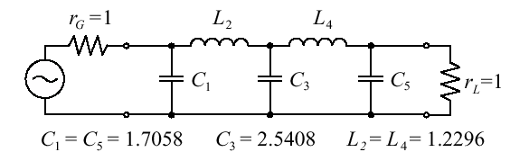
Filter Realization Example
5th order 0.5 dB ripple Chebyshev LPF
g₁ = g₅ = 1.7058, g₂ = g₄ = 1.2296, g₃ = 2.5408, g₆ =1.0

Slide 12
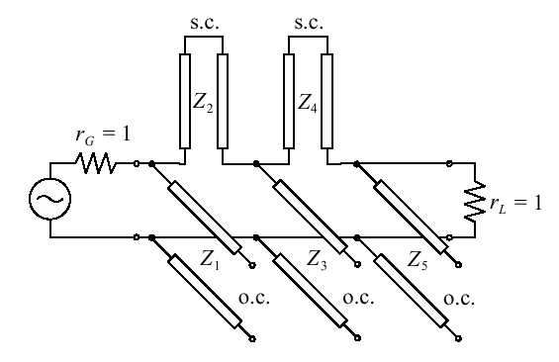
Filter Realization Example
Y₁ = Y₅ = 1.7058, Z₂ = Z₄ = 1.2296, Y₃ = 2.5408; and Z₁ = Z₅ = 1/1.7058, Z₃ = 1/2.5408

Slide 13
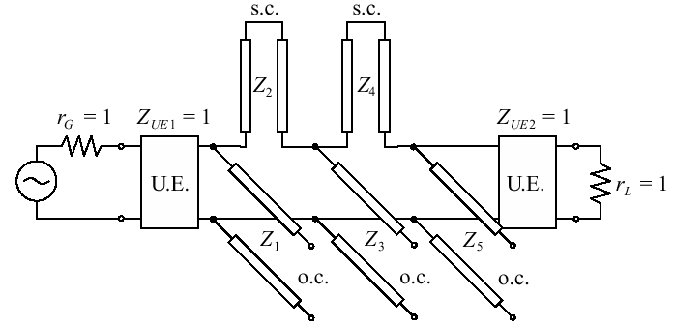
Filter Realization Example
Utilizing Unit Elements to convert series stubs to shunt stubs

Slide 14
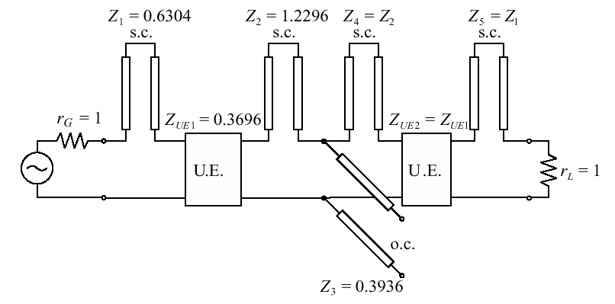
Filter Realization Example
Apply Kuroda’s Identities to eliminate first shunt stub to series stub

Slide 15
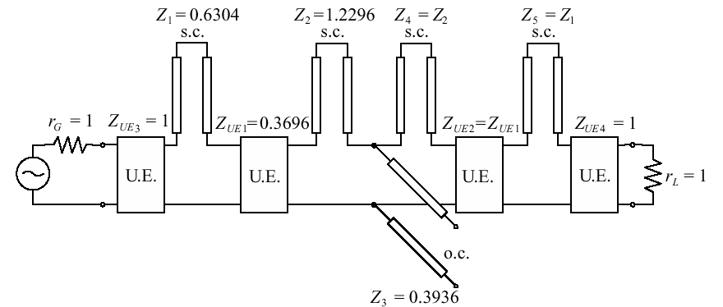
Filter Realization Example
Deploy second set of UE’s in preparation for converting all series stubs to shunt stubs

Slide 16
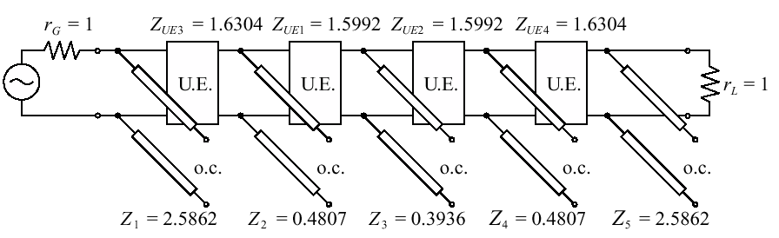
Filter Realization Example
Apply Kuroda’s Identities to eliminate all series stubs to shunt stubs
Z₁ = 1/Y₁ =NZ₂ = (1+Z₂/Z₁)Z₂ =1+(1/0.6304); Z₂ = 1 and Z₁ = 0.6304

Slide 17
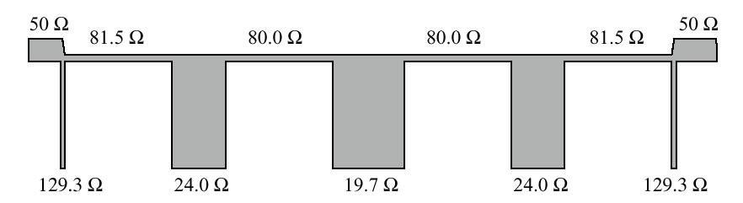
Filter Realization Example
Final Implementation

Slide 18
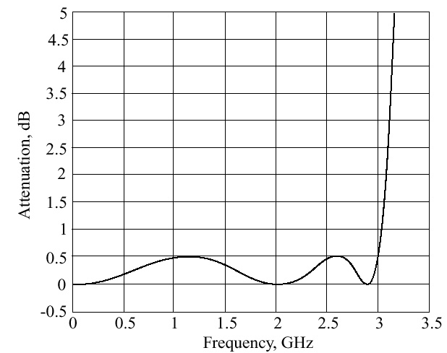
Filter Realization Example
Frequency Response of the Low Pass Filter

Slide 19
Lumped Parameter Band-Pass Filter Design
Design an N=3 band-pass maximally flat (Butterworth) filter with a center frequency of 900 MHz. The Bandwidth of the filter is 20% ; That is, BW = (0.20)(900 MHz) = 1.8 MHz or ±0.9 MHz.
From the Maximally Flat Low Pass Prototype Table 5-2,
g₀ = g₄ = 1, g₁ = g₃ = 1, g₂ = 2

Slide 20
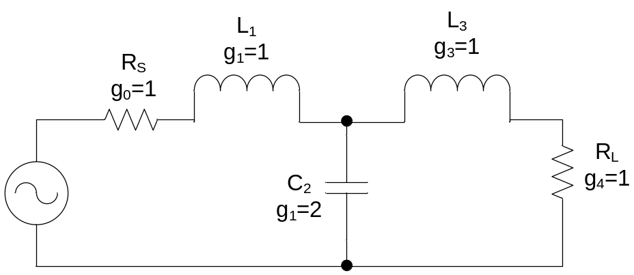
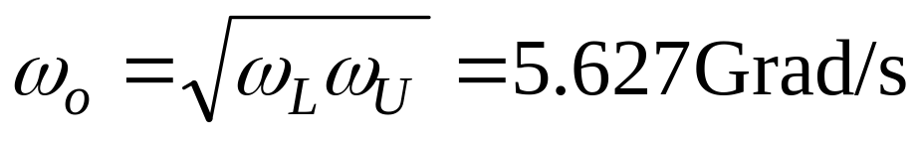
Low Pass Prototype Filter
Where the normalized center frequency is
ω_{c} = 1, ω_{L} = 1.1(2π·900 MHz), and
ω_{U} = 0.9(2π·900 MHz)
So that ω_{U} - ω_{L} = 1.13Grad/s and

Slide 21
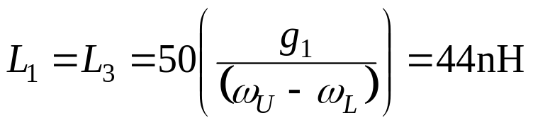
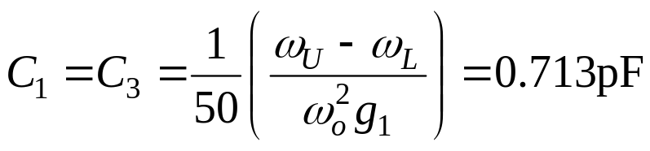
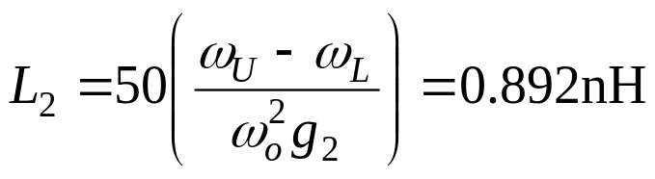
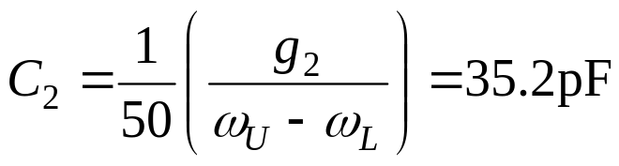
Finding the Filter Components

Slide 22
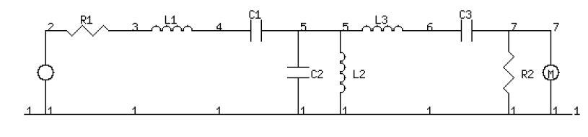
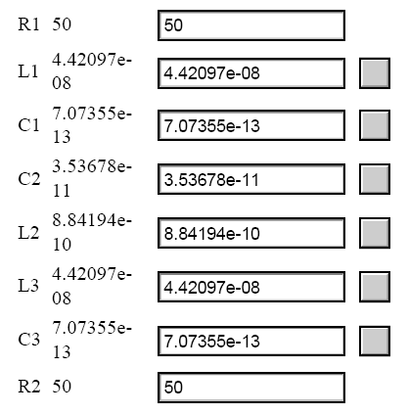
Filter Simulation with Ansoft Designer

Slide 23
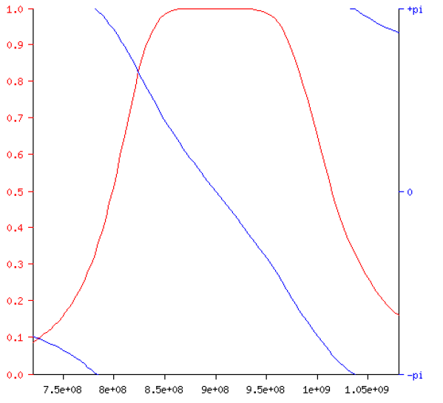
Filter Simulation with Ansoft Designer

Slide 24
Some Observations On The Results
Values of components are unreasonable
Some other method for implementing the filter design goals must be found
Solution: Use distributed filters using waveguides
Richardson Transforms and Kuroda’s Identities

Slide 25
Richards Transformation:
Lumped to Distributed Circuit Design

Slide 26
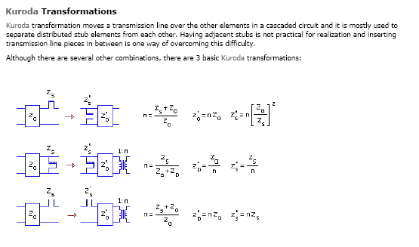
Kuroda Transforms

